Slide 1
SIEGE 2012
SOUTHERN INTERACTIVE ENTERTAINMENT GAME EXPO
Law Relating To Video Games
Year In Review
2012
By Rob Hassett,
Casey Gilson PC,
and
General Counsel
GA Game Developers Assoc.

Slide 2
DISCLAIMER
This presentation is provided for general educational purposes only and does not constitute legal advice. For legal advice you must consult with your own attorney.

Slide 3
TABLE OF CONTENTS
Apple, Inc. v. Samsung Electronics: Page 04
Crowdfunding: Page 48
GA Tax Credits for V Game Dev Page 58

Slide 4
Apple, Inc. v. Samsung Electronics Co., Ltd.
The Jury Verdict of $1,049,343,540.00 will be, if not reduced or reversed, the largest patent infringement award in history. Claims were for utility patent infringement, design patent infringement, registered trade dress infringement, registered trade dress dilution, and unregistered trade dress dilution.

Slide 5
Attorneys in Lawsuit
Plaintiff (Apple) had at least 53 Attorneys.
Defendant (Samsung Electronics) had at least 34 attorneys (there are 2 other Samsung Defendants).

Slide 6
IMPORTANT JURY INSTRUCTIONS
UTILITY PATENTS - DEFINITION
[For a utility patent to be granted for an invention, the invention must be novel, non-obvious and useful.]
Infringement - preponderance of evidence
Invalidity - clear and convincing evidence

Slide 7
Important Jury Instructions
Utility Patent - Obviousness
Not all innovations are patentable. A utility patent claim is invalid if the claimed invention would have been obvious to a person of ordinary skill in the field at the time of invention.

Slide 8
Utility Patent Damages – Lost Profits
In this case, Apple seeks to recover lost profits for some of Samsung’s sales of allegedly infringing products, and a reasonable royalty on the rest of Samsung’s allegedly infringing sales.

Slide 9
Utility Patent Damages – Lost Profits (cont.)
To recover lost profits for infringing sales, Apple must show that but for the infringement, there is a reasonable probability that it would have made sales that Samsung Electronics Company, Samsung Electronics America, and Samsung Tele-communications America made of the infringing products. Apple must show the share of Samsung’s sales that it would have made if the infringing products had not been on the market.

Slide 10
Utility Patent Damages – Lost Profits (cont.)
You must allocate the lost profits based upon the customer demand for the patented feature of the infringing products. That is, you must determine which profits derive from the patented invention that Samsung sells, and not from other features of the infringing products.

Slide 11
Utility Patent Damages – Reasonable Royalty – Entitlement
If Apple has not proved its claim for lost profits, or has proved its claim for lost profits for only a portion of the infringing sales, then Apple should be awarded a reasonable royalty for all infringing Samsung sales for which Apple has not been awarded lost profits damages.

Slide 12
Design Patents
[A design patent is a patent granted on the ornamental design of a functional item. It can apply to screens and icons]
Unlike utility patents, a design patent can have only one claim. That claim covers all the figures in the patent. It is permissible to illustrate more than one embodiment of a design in a single design patent application.

Slide 13
Design Patents (cont.)
To determine direct infringement of a design patent, you must compare the overall appearances of the accused design and the claimed design.

Slide 14
Design Patents (cont.)
If you find by a preponderance of the evidence that the overall appearance of an accused Samsung design is substantially the same as the overall appearance of the claimed Apple design patent, and that the accused design was made, used, sold, offered for sale, or imported within the United States, you must find that the accused design infringed the claimed design.

Slide 15
Design Patents (cont.)
Two designs are substantially the same if, in the eye of an ordinary observer, giving such attention as a purchaser usually gives, the resemblance between the two designs is such as to deceive such an observer, inducing him to purchase one supposing it to be the other. You

Slide 16
Design Patents (cont.)
do not need, however, to find that any purchasers actually were deceived or confused by the appearance of the accused Samsung products. You should consider any perceived similarities or differences between the patented and accused designs. Minor differences should not prevent a finding of infringement.

Slide 17
Design Patents – Obviousness
Even if a design is not anticipated by a single reference, it may still be invalid if the claimed design would have been obvious to a designer of ordinary skill in the field at the time the design was made.

Slide 18
Defendants’ Profits
If you find infringement by any Samsung defendant and do not find Apple’s design patents are invalid, you may award Apple that Samsung defendant’s total profit attributable to the infringing products.

Slide 19
Design Patent Damages - Lost Profits
Apple may alternatively recover compensatory damages in the form of lost profits. As previously explained, Apple may not recover both Samsung’s profits and compensatory damages on each sale of an infringing product.

Slide 20
Design Patent Damages – Reasonable Royalty
If Apple has not proved its claim for lost profits or has not proved its claim to Samsung’s profits, then Apple should be awarded a reasonable royalty for all infringing sales.…

Slide 21
Trade Dress Jury Instructions
For each of Apple’s trade dress dilution and infringement claims, the first issue you will have to decide is whether the Apple trade dress is protectable (or valid). An asserted trade dress is only protectable if the trade dress design as a whole, as opposed to its individual features standing alone, is both distinctive and non-functional.

Slide 22
Trade Dress Dilution and Infringement – Definition of Trade Dress
Trade dress is the non-functional physical detail and design of a product, which identifies the product’s source and distinguishes it from the products of others.

Slide 23
Trade Dress Dilution and Infringement –
Definition of Trade Dress (cont.)
Trade dress is the product’s total image and overall appearance, and may include features such as size, shape, color, color combinations, texture, or graphics.

Slide 24
Trade Dress Dilution and Infringement –
Definition of Trade Dress (cont.)
… Apple trade dress is protectable if the trade dress:
1. has acquired distinctiveness through secondary meaning; and
is non-functional.

Slide 25
INFRINGEMENT—LIKELIHOOD OF CONFUSION
Apple must prove by a preponderance of the evidence that a reasonably prudent consumer in the marketplace is likely to be confused about the source of [a Samsung product].
Apple must show more than simply a possibility of such confusion.

Slide 26
DILUTION
Apple contends that Samsung has diluted Apple’s asserted iPhone- and iPad-related trade dresses.
“Dilution” means a lessening of the capacity of a famous trade dress to identify and distinguish goods or services, regardless of the presence or absence of competition, actual or likely confusion, mistake, deception, or economic injury.

Slide 27
TRADE DRESS DAMAGES IN GENERAL
If you find that Apple has proven by a prepon-derance of the evidence that Samsung Electronics Company, Samsung Electronics America, and/or Samsung Telecommunications America have diluted or infringed upon any of Apple’s trade dresses, then there are two forms of monetary relief to which Apple may be entitled: Apple’s actual damages or each Samsung entity’s profits.

Slide 28
Apple’s Utility Patents
a. U.S. Patent No. 7,469,381 (claim 19) – List Scrolling and Document Translation, Scaling and Rotation on a Touch-Screen Display – The direction of scrolling or translation may be reversed in response to intersecting a virtual boundary corresponding to a terminus of the list or an edge of the electronic document.

Slide 29
Apple’s Utility Patents (cont.)
For example, during scrolling, a displayed portion of the list of items may appear to bounce off of a boundary of the window in the touch-sensitive display when a beginning or an end of the list of items is reached.

Slide 30
Apple’s Utility Patents (cont.)
b. U.S. Patent No. 7,844,915 (claim 8) - Application Programming Interfaces for Scrolling Operations

Slide 31
Apple’s Utility Patents (cont.)
c. U.S. Patent No. 7,864,163 (claim 50) – Portable electronic device, method, and graphical user interface for displaying structured electronic documents – includes touch-screen tap-to- zoom feature

Slide 32
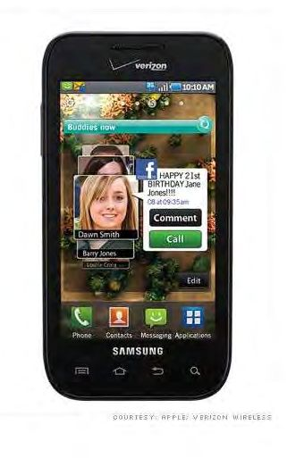
Apple Design Patent No. D618,677 – Ornamental Design Of The Electronic Device As Shown
Apple Design Patent D618,677
Samsung Fascinate which infringes upon D618,677

Slide 33
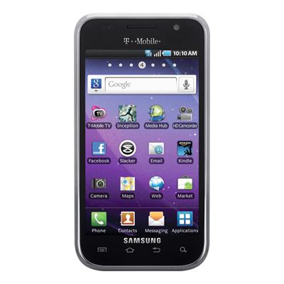
Apple Design Patent No. D593,087 – Ornamental Design Of The Electronic Device As Shown
Apple’s Patent No. D593,087
Samsung’s Galaxy S4G Infringes upon Apple’s Patent No. D593,087

Slide 34
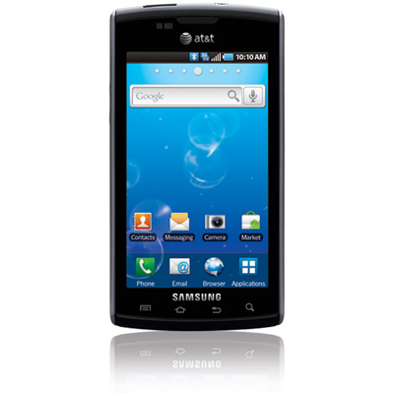
Apple’s Design Patent No. D604,305 - Graphical User Interface For A Display Screen Or Portion Thereof
Apple’s D604,305
Samsung’s Captivate which infringes upon Apple’s D604,305

Slide 35
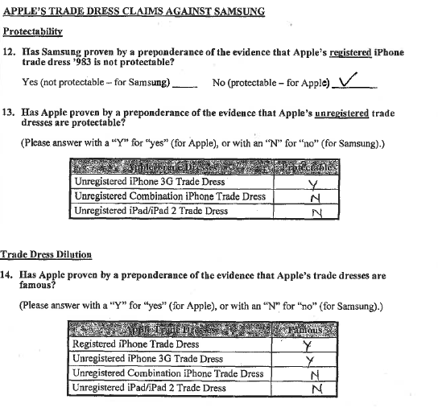
Apple’s Trade Dress Verdict

Slide 36
U.S. Registration No. 3,470,983 – is a registered trade dress for the overall design of the product, including the rectangular shape, the rounded corners, the silver edges, the black face, and the display of sixteen colorful icons

Slide 37
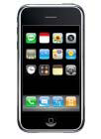
Apple’s Registered Trade Dress
Apple Registered Trade Dress
No. 3,470,983
Samsung’s Fascinate infringes upon Apple Trade Dress – No. 3,470,983

Slide 38
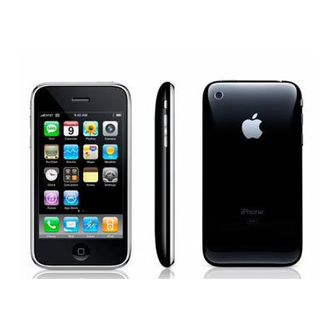
Apple’s Unregistered Trade Dress
(Jury found protectable)
iPhone 3G

Slide 39
Apple’s Unregistered Trade Dress
Unregistered Combination iPhone Trade Dress
(Jury found unprotectable)
Unregistered iPad/iPad2 Trade Dress
(Jury found unprotectable)

Slide 40
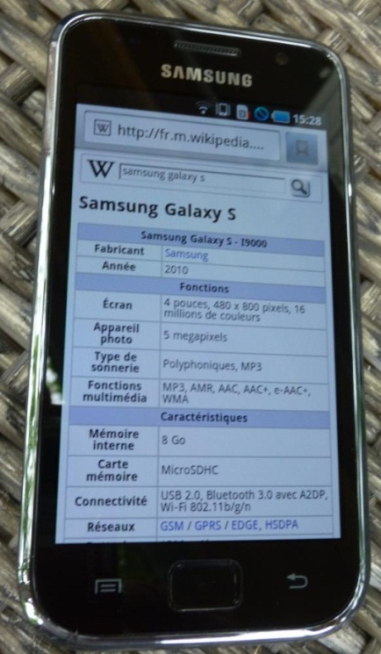
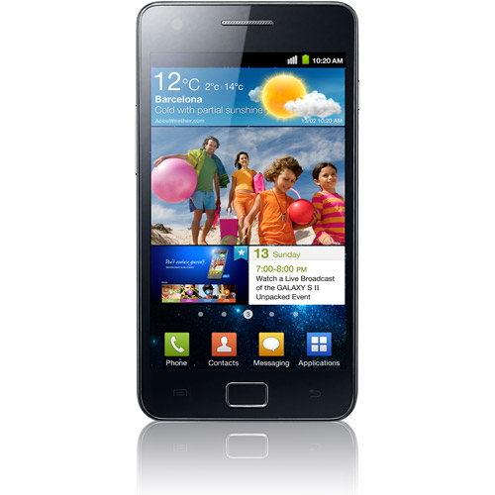
Various Samsung Products
Found To Infringe Upon Apple Patents
Galaxy S (original)
Galaxy SII

Slide 41
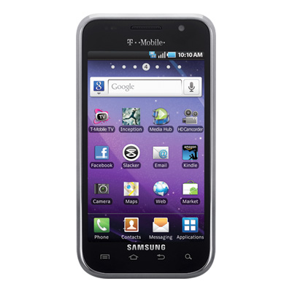
Various Samsung Products
Found To Infringe Upon Apple Patents (cont.)
Galaxy S4G

Slide 42
 | UTILITY PATENT | DESIGN PATENT | TRADE DRESS | AMOUNT
Captivate (JX1011) | Y | Y | N | 80,840,162
Continuum (JX 1016) | Y | Y | N | 16,399,177
Droid Charge (JX 1025) | Y | Y | N | 50,672,869
Epic 4G (JX 1012) | Y | Y | N | 130,180,896
Exhibit 4G (JX 1028) | Y |  | N | 1,081,820
Fascinate (JX 1013) | Y | Y | Y | 143,539,179
Galaxy Ace (JX 1030) | Y | N |  | 0
Galaxy Prevail (JX 1022) | Y |  | N | 57,867,383
Galaxy S (i9000) (JX 1007) | Y | Y | N | 0
Galaxy S 4G (JX 1019) | Y | Y | Y | 73,344,668
Galaxy S II (AT&T) (JX 1031) | Y | Y | N | 40,496,356
Galaxy S II (i9100) (JX 1032) | Y | Y | N | 0

Slide 43
 | UTILITY PATENT | DESIGN PATENT | TRADE DRESS | AMOUNT
Galaxy S II (T-Mobile) (JX 1033) | Y | Y | N | 83,791,708
Galaxy S II (Epic 4G Touch) (JX 1034) |  | Y | N | 150,326,988
Galaxy S II (Skyrocket) (JX 1035) |  | Y | N | 32,273,558
Galaxy S II Showcase (i500) (JX 1017) |  | Y | Y | 22,502,156
Galaxy Tab (JX 1036) | Y |  |  | 1,966,691
Galaxy Tab 10.1 (WiFi) (JX 1037) | Y | N |  | 833,076

Slide 44
 | UTILITY PATENT | DESIGN PATENT | TRADE DRESS | AMOUNT
Galaxy Tab 10.1 (4G LTE) (JX 1038) |  | N |  | 0
Gem (JX 1020) | Y |  |  | 6,075,585
Indulge (JX 1026) | Y | Y |  | 16,011,184
Infuse 4G (JX 1027) | Y | Y | N | 44,792,974
Intercept (JX 1009) | N |  |  | 0
Mesmerize (JX 1015) | Y | Y | Y | 53,123,612
Nexus (JX 1023) | Y |  |  | 1,828,297
Replenish (JX 1024) | Y |  |  | 3,350,256
Transform (JX 1014) | Y |  |  | 953,060
Vibrant (JX 1010) | Y | Y | Y | 89,673,957
TOTAL

Slide 45
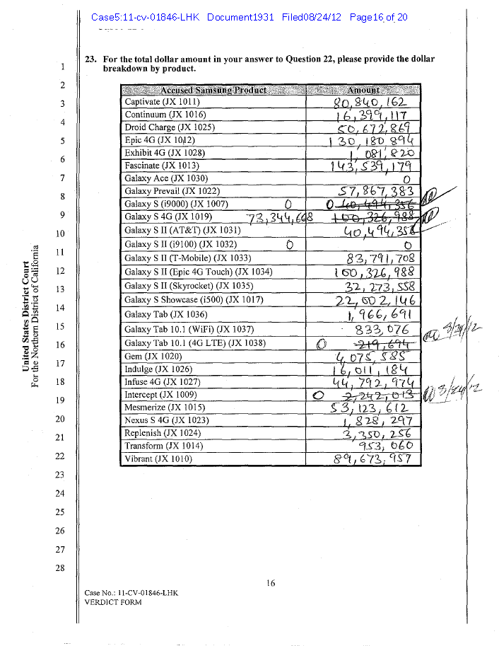
How Verdict was Computed

Slide 46
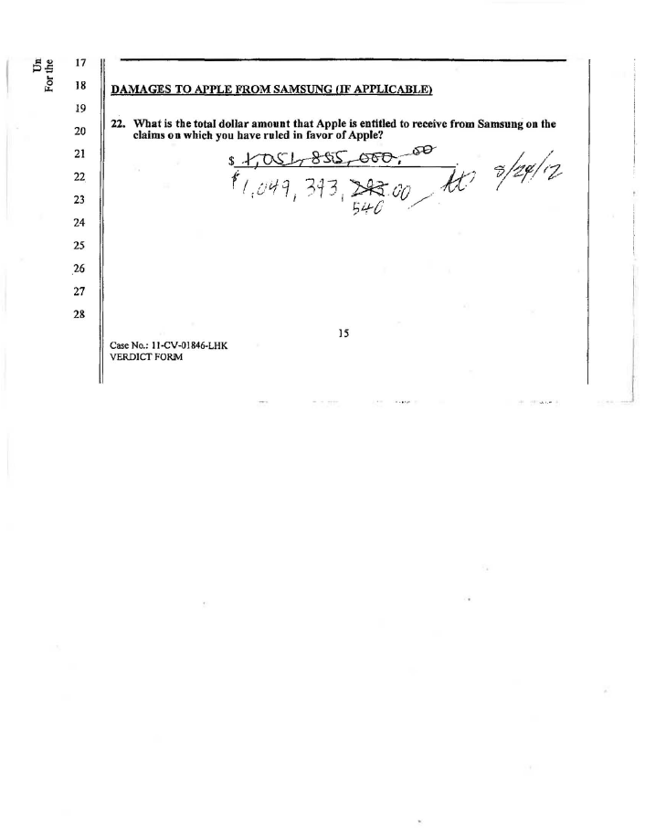
Handwritten/Corrected $1B Verdict

Slide 47
TAKEAWAYS
1. Utility Patents vs. Design Patents
a. Effect on jury
b. Profits recoverable
Burdens of proof for patent infringement vs. invalidating patent
3. Trade dress difficulties and potential

Slide 48
SIEGE 2012
SOUTHERN INTERACTIVE ENTERTAINMENT GAME EXPO
CROWDFUNDING

Slide 49
I. TYPES OF CROWDFUNDING
A. Gifts and Grants
B. Presales
  Premiums
D. Investments Prohibited
  E. Kickstarter.com
  GoFundMe.com

Slide 50
II. FEDERAL AND STATE SECURITY LAWS
A. Registered (Public) Offering - $800K+
Private Offering – No General Solicitation or Advertising
Many types of private offerings with different requirements – Many State Law requirements are onerous
D. Therefore most popular approach to private offerings - Rule 506

Slide 51
RULE 506
The issue of a 506 offering is exempted from all the various security law requirements imposed by each state other than a relatively low filing fee and completion and filing of a short form in each state.

Slide 52
SORT OF CROWDFUNDING ALLOWED UNDER RULE 506
Rule 506 is generally permissive for sales to purchasers who are reasonably believed to be “ACCREDITED INVESTORS”
Websites that allow only accredited investors who are members to view pitches from entrepreneurs are considered to be facilitating only private offerings:
GoBigNetwork.com
Fundable.com

Slide 53
JOBS ACT
In April of 2012 President Obama signed into law the “Jumpstart Our Business Startups Act.”
Titles II and III of that Act will, upon issuance of final regulations by the SEC and subject to those regulations, permit Crowdfunding in connection with private offerings.

Slide 54
Title II of the Jobs Act is referred to as the “Access to Capital for Job Creators Act.”
It would permit solicitation and general advertising, under Rule 506, provided that all sales are made only to accredited investors.
The SEC has issued proposed rules which would put quite a burden on issuers to make sure that each investor is truly accredited.

Slide 55
Title III. Crowdfunding
Title III is referred to as the “Capital Raising Online While Deterring Fraud and Unethical Non-Disclosure Act of 2012”- also called the “Crowdfund Act.”
$1M cap
Net worth less than $100,000
Investment limited to the greater of $2,000 or 5% of annual income or net worth of investor

Slide 56
If annual income or net worth of investor is equal to or more than $100,000 investment may invest the greater of 10% of annual income or net worth

Slide 57
The changes relating to having general solicitation and advertising permitted under Rule 506 will not go into effect until pertinent rules are issued by the SEC in final form. A proposed rule that would allow the expansion of 506 when dealing with accredited investors only was issued on August 30, 2012. That is not a final rule.

Slide 58
SIEGE 2012
SOUTHERN INTERACTIVE ENTERTAINMENT GAME EXPO
GEORGIA INCOME TAX CREDITS FOR
THE DEVELOPMENT OF VIDEO GAMES
(CHANGES NOTED WERE MADE IN 2012. MOST OF THOSE CHANGES WILL BE EFFECTIVE AS OF JANUARY 1, 2013)

Slide 59
Subject to certain requirements and restrictions, Georgia’s tax credit for video game developers is 20% of investment in game development in projects approved by the State plus another 10% more if the Georgia logo appears in units sold and in online promotions.

Slide 60
1. Any interactive entertainment production company must, to receive the credit, have not had gross income that was greater than $100M (per year?). (Added in 2012)
  Any credit requires approval of the Dept. of Economic Development.
  The minimum investment a video game developer must make in video game development in Georgia in one or more projects certified by the state in order to qualify for the credit is $500,000.
  4. The portion of any salary which exceeds $500,000 for a single production will not be counted in computing the tax credit due.

Slide 61
5. “Interactive entertainment” is not a type of purely audio-visual work subject to the film office as are the other categories of works to which the tax credit applies. The product must be intended for multi-market commercial distribution via theatres, video on demand, direct-tv, dvd, digital platforms designed for the distribution of interactive games, licensing for exhibition by individual television stations, groups of stations, networks, advertiser supported sites, cable television stations or public broadcasting stations. (Much changed in 2012)

Slide 62
6. The following channels of trade were deleted from the statute in 2012:
Corporations, live venues, the Internet or any other channel of exhibition.
7. All credits require pre-certification by the Dept. of Economic Development.

Slide 63
8. There is an overall cumulative cap of $25M and there is a $5M cap per company which appears to be per year. (added in 2012)

Slide 64
For Further Information:
Rob Hassett
Casey Gilson P.C.
Six Concourse Parkway, Suite 2200
Atlanta, GA 30328
770-512-0300
rob@internetlegal.com
www.internetlegal.com
www.TellMeSomethingIdontAlreadyKnow.com
www.caseygilson.com

